Slide 1

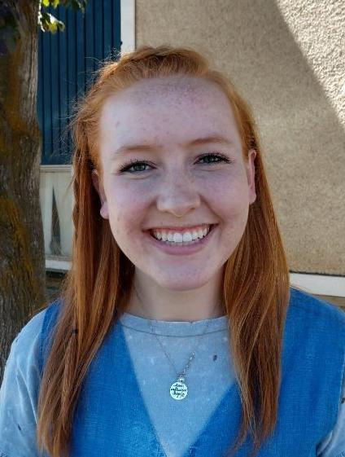
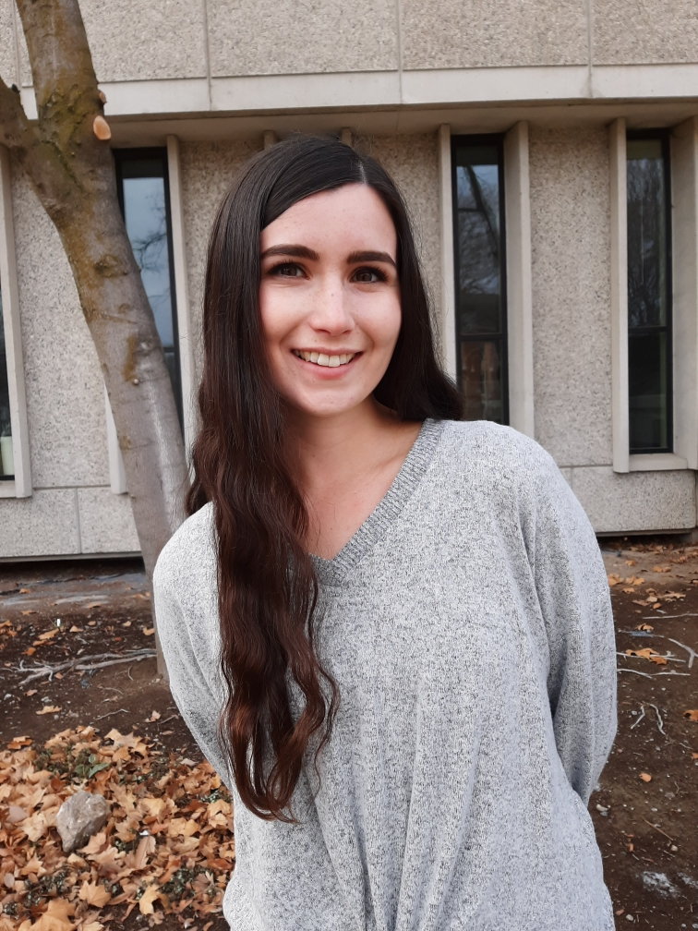

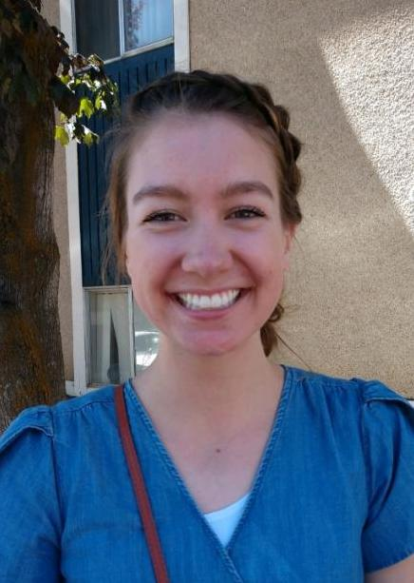
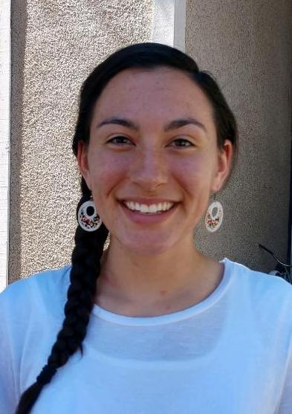
Apartment 113
Jordyn Fail
801-718-7799
Caitlin Ball
801-898-7326
Jaidyn Eardley
208-800-2844
Annie Estes
801-503-8811
Carly Ames
360-451-3096
Amber Felicia
385-447-9893

Slide 2



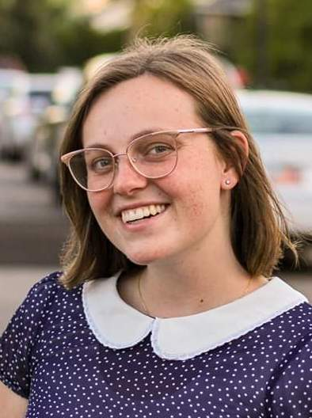
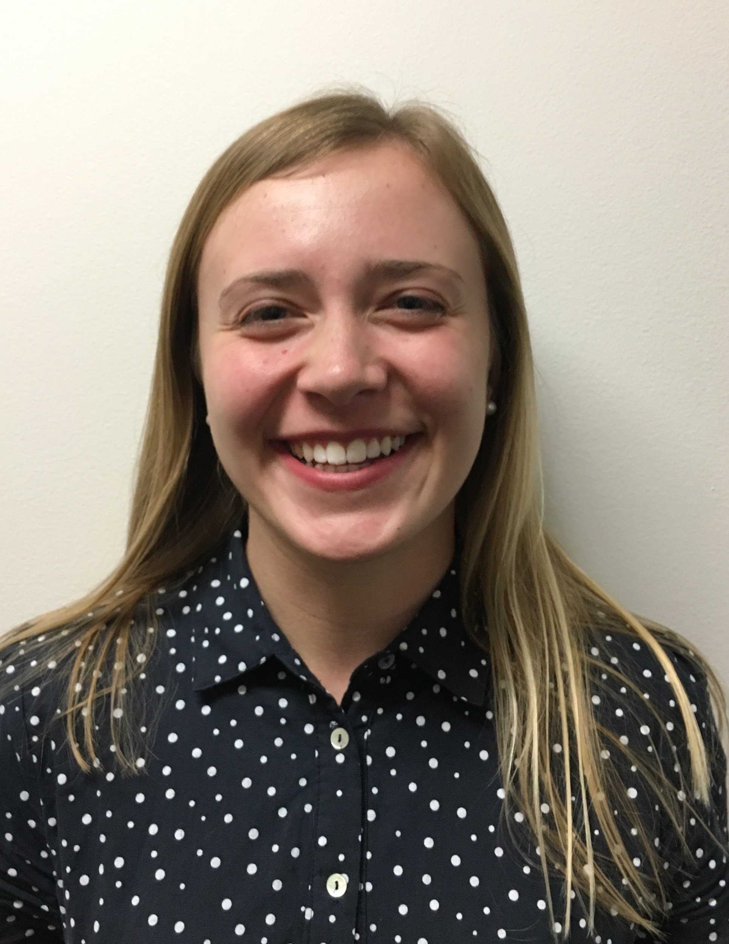
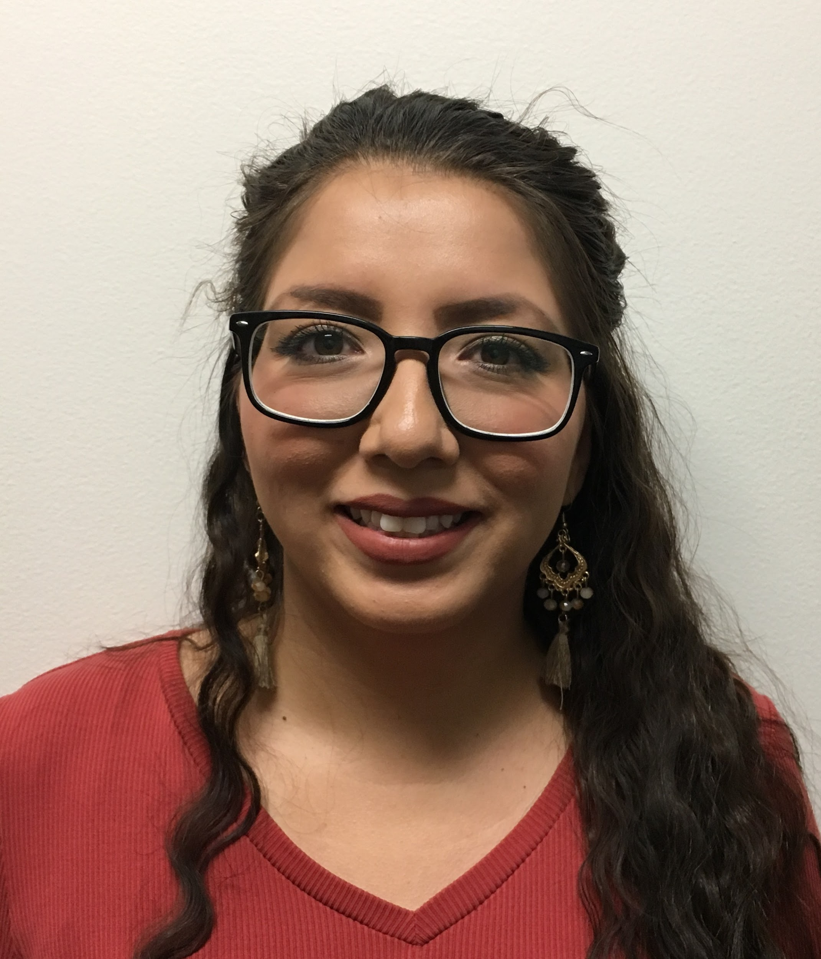
Apartment 114
Maeghan Darby
901-603-9547
Amanda Brinkman
801-598-2145
Rebekah Hill
662-292-6949
Anneli Howells
801-358-6239
Victoria Graff
801-864-5699
Kassandra Perez
209-422-7263

Slide 3
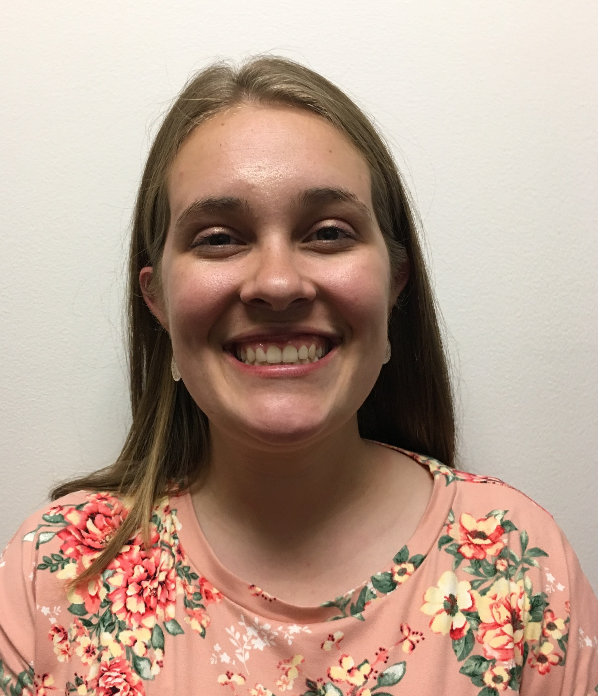
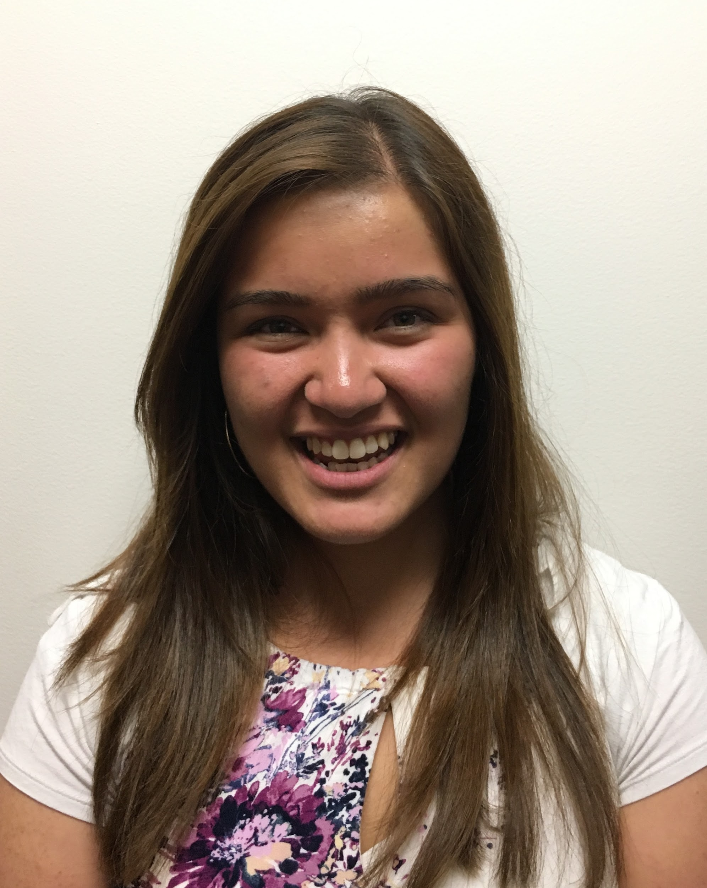
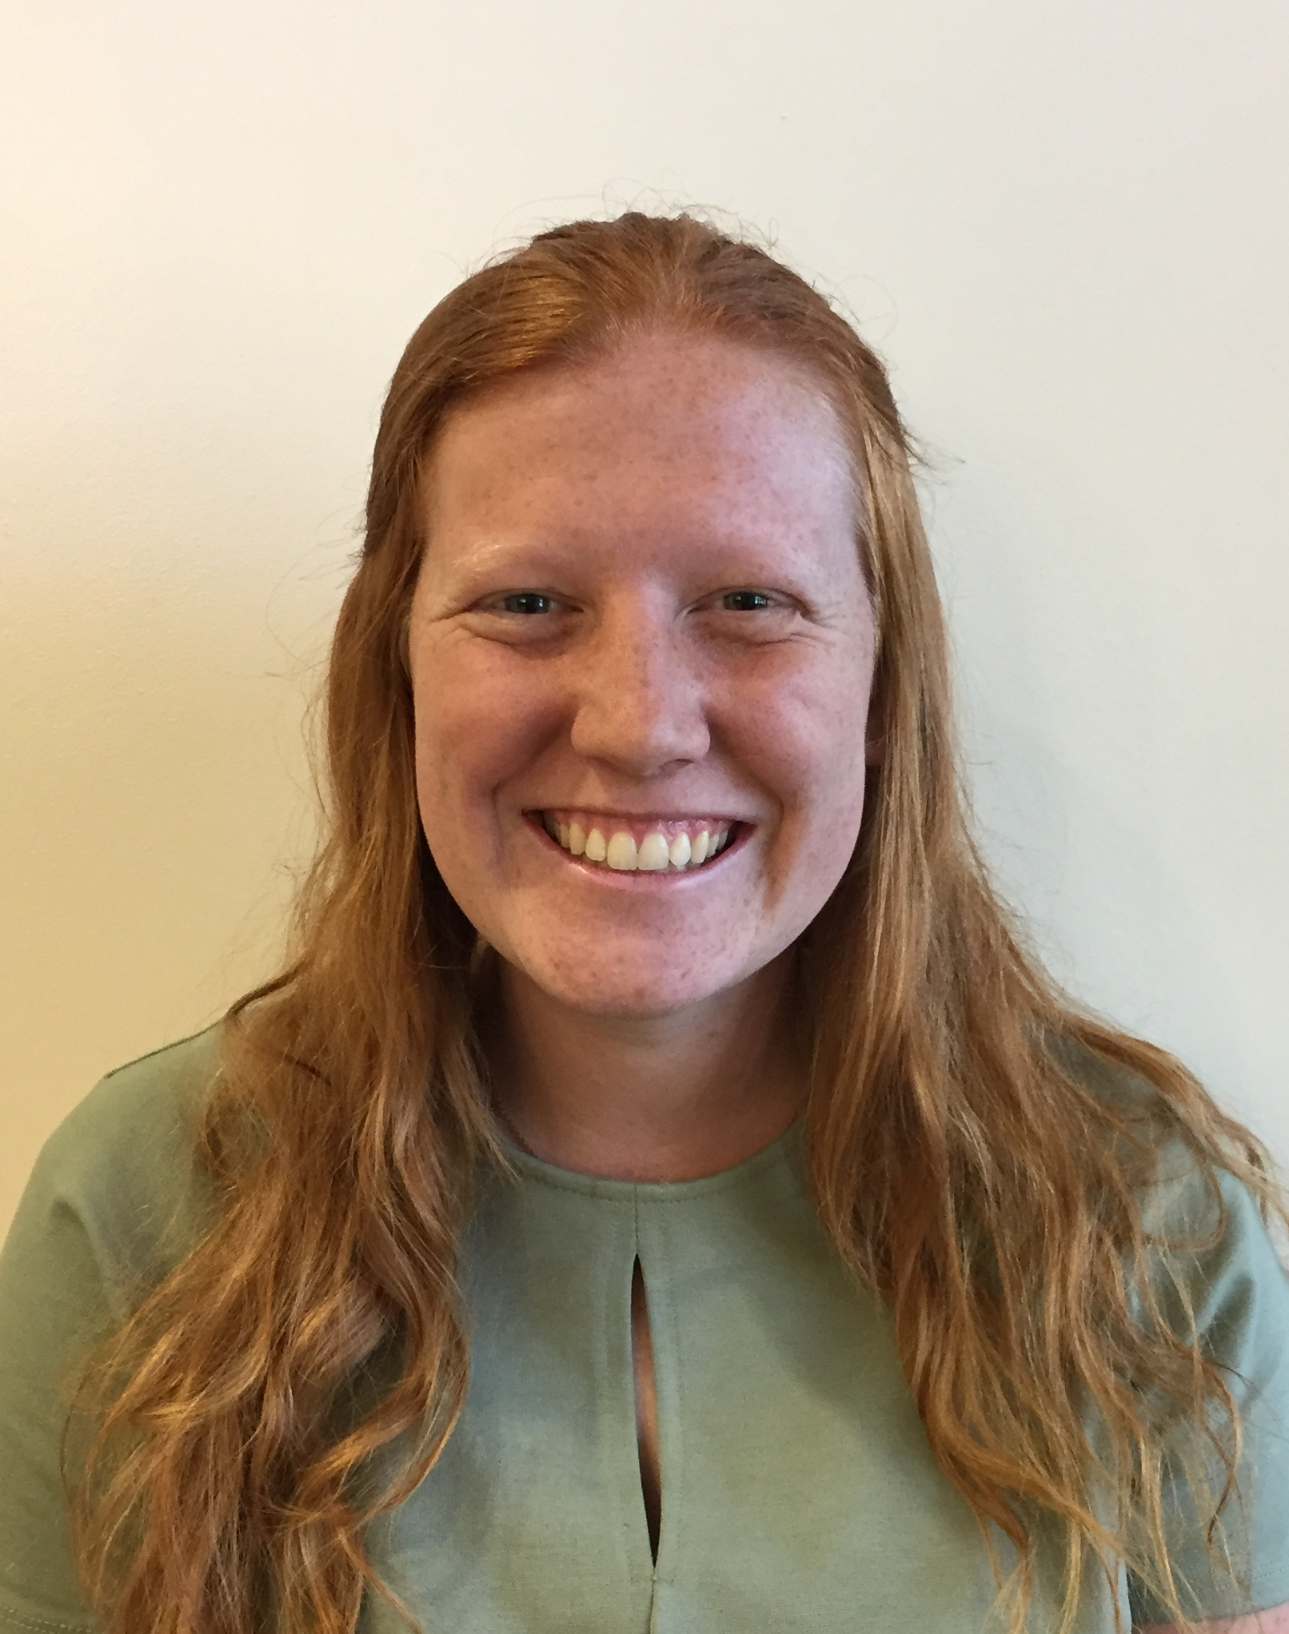
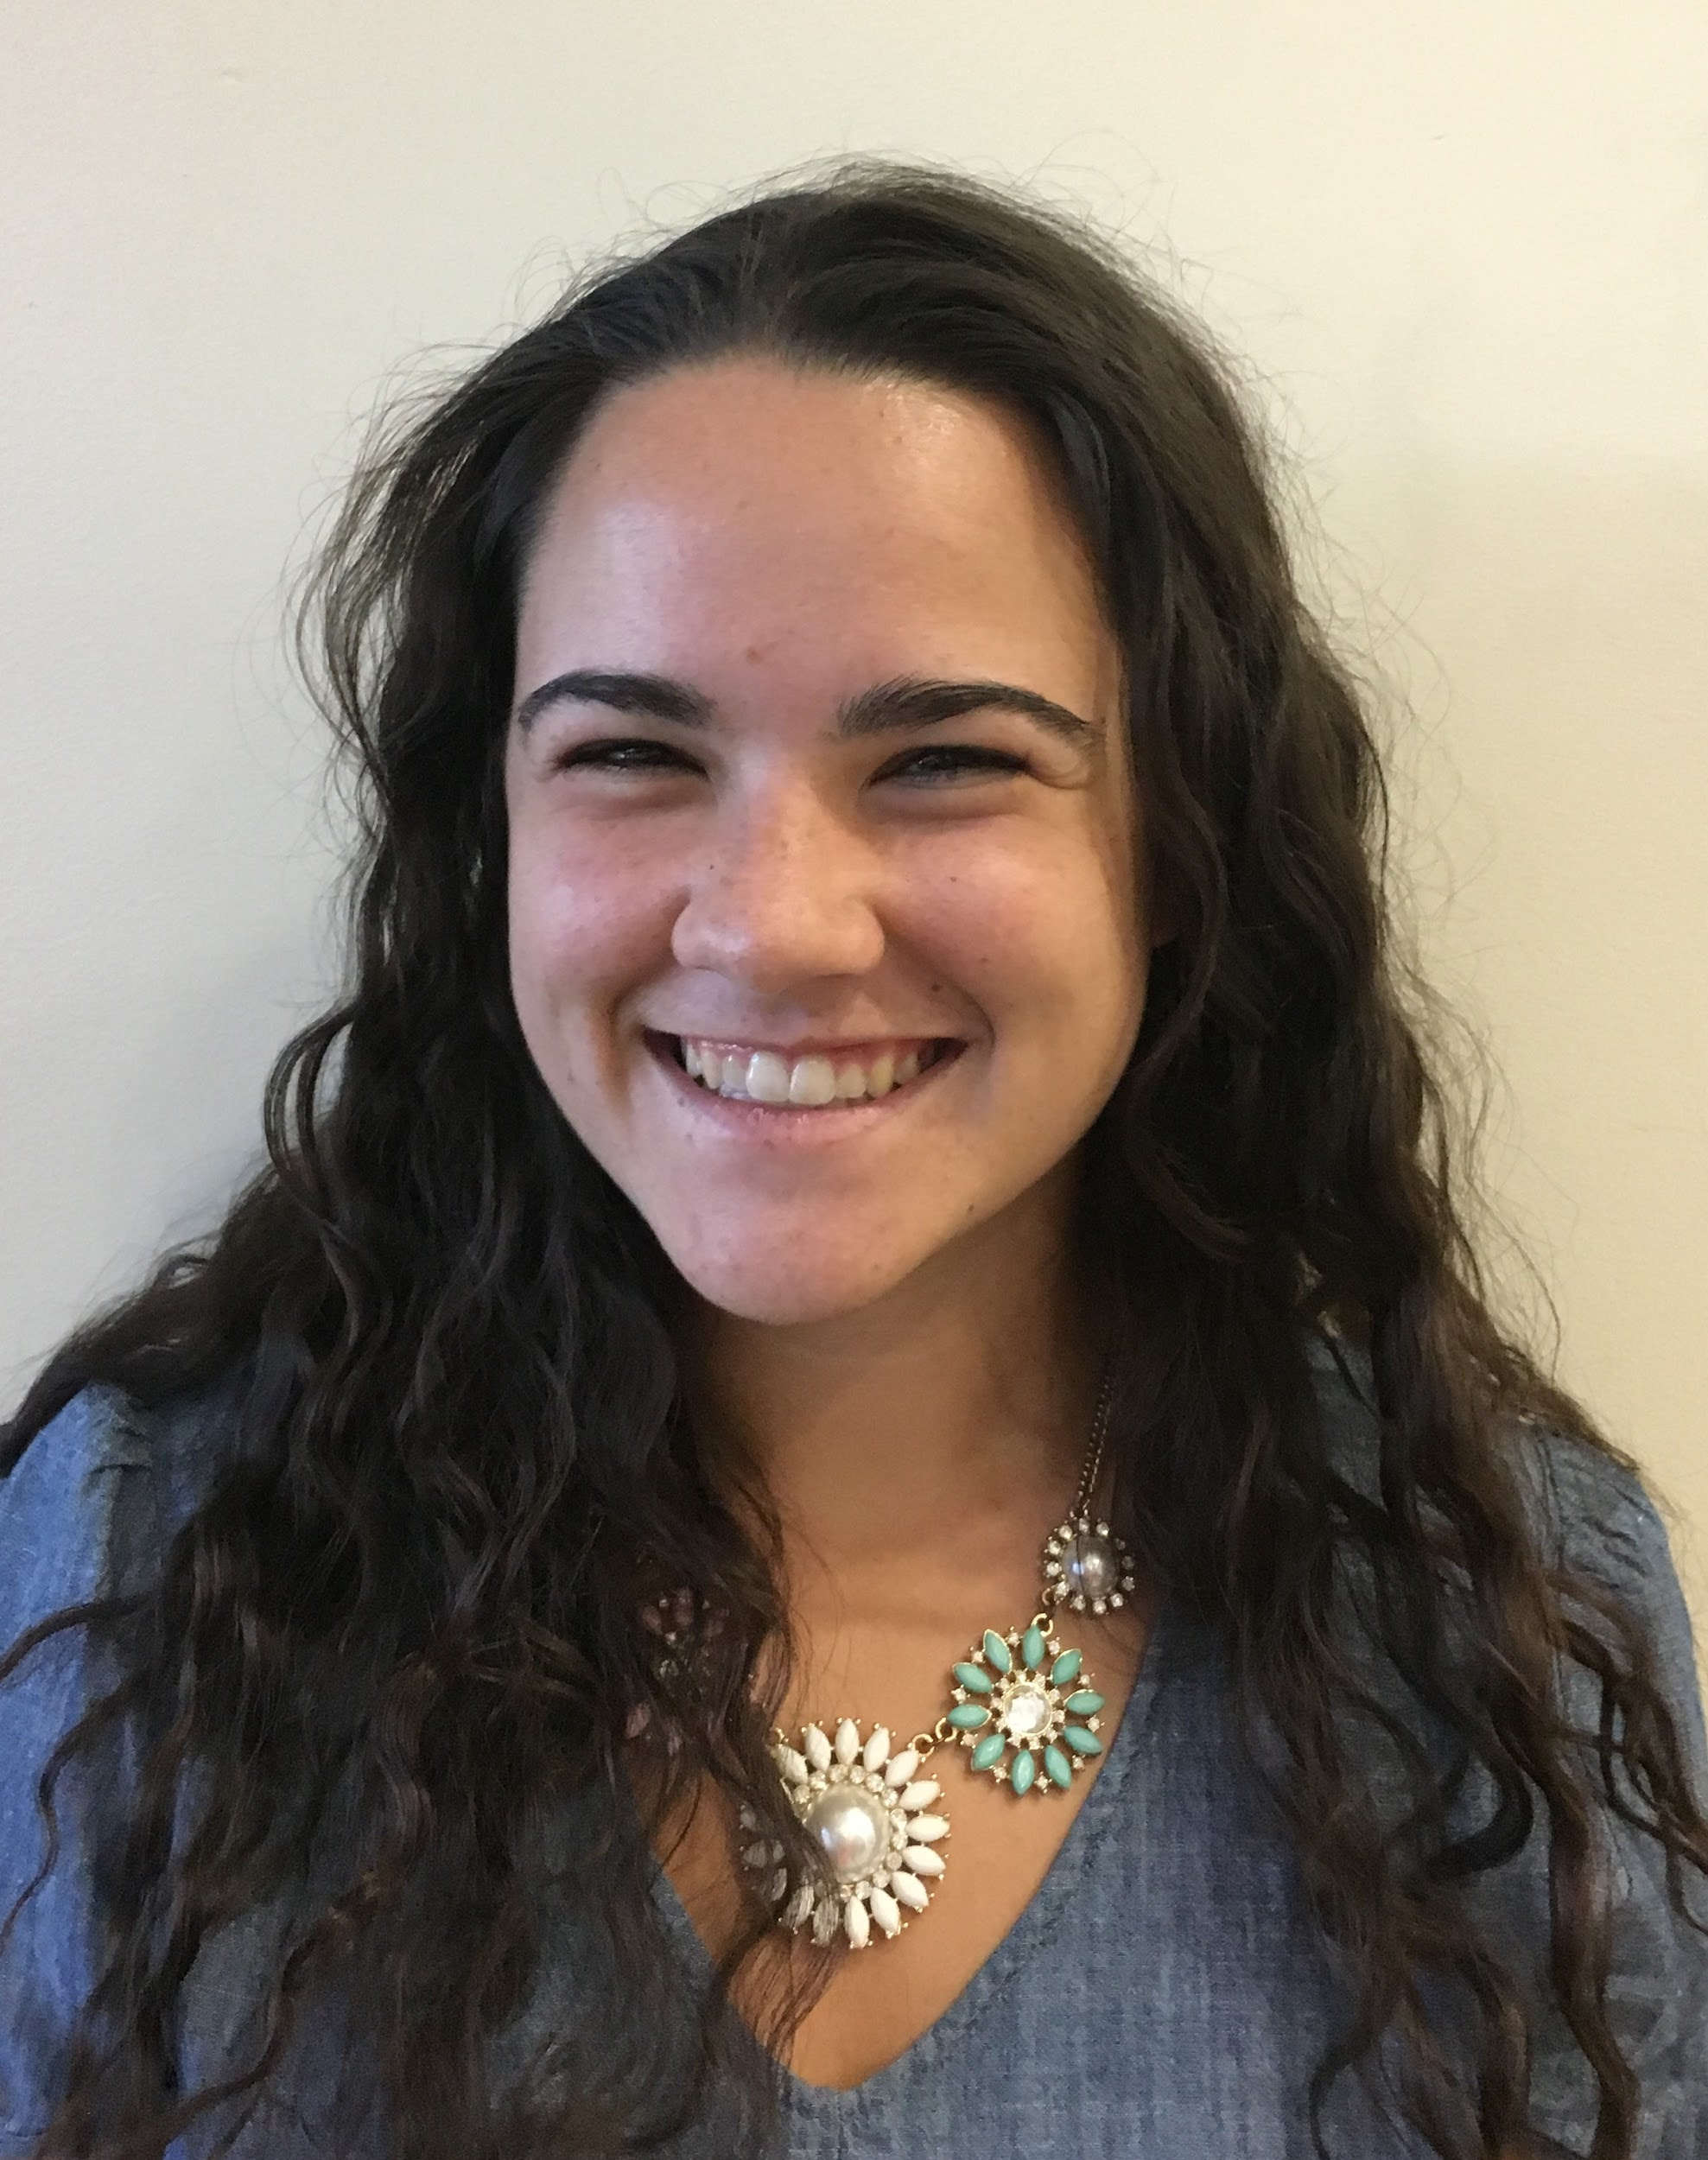
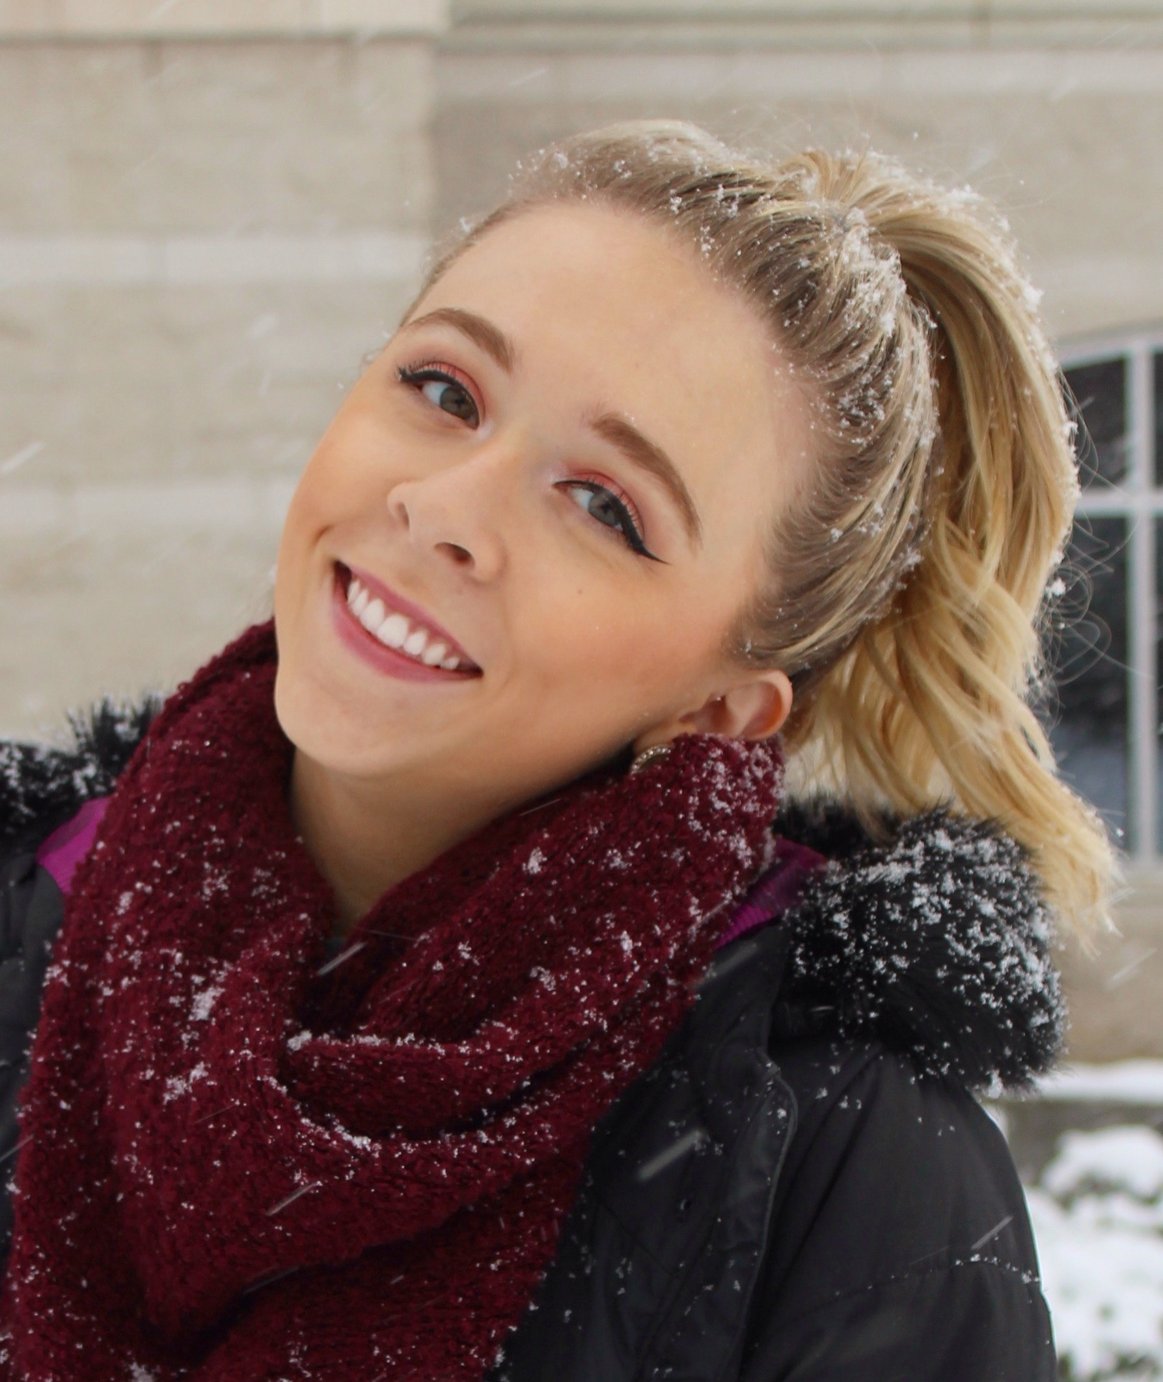
Apartment 115
Jenna Schaelling
801-888-7547
Sarah Lawrence
801-851-0045
Ysa Ng
509-432-4296
Allison McArthur
661-599-8882
Maile Dillender
425-387-8873
Katherine McCafferty
443-903-0295

Slide 4
Apartment 116
First Last
555-555-5555
First Last
555-555-5555
First Last
555-555-5555
First Last
555-555-5555
First Last
555-555-5555
First Last
555-555-5555

Slide 5
Apartment 117
First Last
555-555-5555
First Last
555-555-5555
First Last
555-555-5555
First Last
555-555-5555
First Last
555-555-5555
First Last
555-555-5555

Slide 6
Apartment 119
First Last
555-555-5555
First Last
555-555-5555
First Last
555-555-5555
First Last
555-555-5555
First Last
555-555-5555
First Last
555-555-5555

Slide 7
Apartment 213
First Last
555-555-5555
First Last
555-555-5555
First Last
555-555-5555
First Last
555-555-5555
First Last
555-555-5555
First Last
555-555-5555

Slide 8
Apartment 214
First Last
555-555-5555
First Last
555-555-5555
First Last
555-555-5555
First Last
555-555-5555
First Last
555-555-5555
First Last
555-555-5555

Slide 9
Apartment 215
First Last
555-555-5555
First Last
555-555-5555
First Last
555-555-5555
First Last
555-555-5555
First Last
555-555-5555
First Last
555-555-5555

Slide 10
Apartment 216
First Last
555-555-5555
First Last
555-555-5555
First Last
555-555-5555
First Last
555-555-5555
First Last
555-555-5555
First Last
555-555-5555

Slide 11
Apartment 217
First Last
555-555-5555
First Last
555-555-5555
First Last
555-555-5555
First Last
555-555-5555
First Last
555-555-5555
First Last
555-555-5555

Slide 12
Apartment 219
First Last
555-555-5555
First Last
555-555-5555
First Last
555-555-5555
First Last
555-555-5555
First Last
555-555-5555
First Last
555-555-5555

Slide 13
Apartment 315
First Last
555-555-5555
First Last
555-555-5555
First Last
555-555-5555
First Last
555-555-5555
First Last
555-555-5555
First Last
555-555-5555

Slide 14
Apartment 316
First Last
555-555-5555
First Last
555-555-5555
First Last
555-555-5555
First Last
555-555-5555
First Last
555-555-5555
First Last
555-555-5555

Slide 15
Apartment 317
First Last
555-555-5555
First Last
555-555-5555
First Last
555-555-5555
First Last
555-555-5555
First Last
555-555-5555
First Last
555-555-5555

Slide 16
Apartment 109
First Last
555-555-5555
First Last
555-555-5555
First Last
555-555-5555
First Last
555-555-5555
First Last
555-555-5555
First Last
555-555-5555

Slide 17
Apartment 110
First Last
555-555-5555
First Last
555-555-5555
First Last
555-555-5555
First Last
555-555-5555
First Last
555-555-5555
First Last
555-555-5555

Slide 18
Apartment 111
First Last
555-555-5555
First Last
555-555-5555
First Last
555-555-5555
First Last
555-555-5555
First Last
555-555-5555
First Last
555-555-5555

Slide 19
Apartment 112
First Last
555-555-5555
First Last
555-555-5555
First Last
555-555-5555
First Last
555-555-5555
First Last
555-555-5555
First Last
555-555-5555

Slide 20
Apartment 209
First Last
555-555-5555
First Last
555-555-5555
First Last
555-555-5555
First Last
555-555-5555
First Last
555-555-5555
First Last
555-555-5555

Slide 21
Apartment 210
First Last
555-555-5555
First Last
555-555-5555
First Last
555-555-5555
First Last
555-555-5555
First Last
555-555-5555
First Last
555-555-5555

Slide 22
Apartment 211
First Last
555-555-5555
First Last
555-555-5555
First Last
555-555-5555
First Last
555-555-5555
First Last
555-555-5555
First Last
555-555-5555

Slide 23
Apartment 212
First Last
555-555-5555
First Last
555-555-5555
First Last
555-555-5555
First Last
555-555-5555
First Last
555-555-5555
First Last
555-555-5555

Slide 24
Apartment 309
First Last
555-555-5555
First Last
555-555-5555
First Last
555-555-5555
First Last
555-555-5555
First Last
555-555-5555
First Last
555-555-5555

Slide 25
Apartment 310
First Last
555-555-5555
First Last
555-555-5555
First Last
555-555-5555
First Last
555-555-5555
First Last
555-555-5555
First Last
555-555-5555

Slide 26
Apartment 311
First Last
555-555-5555
First Last
555-555-5555
First Last
555-555-5555
First Last
555-555-5555
First Last
555-555-5555
First Last
555-555-5555

Slide 27
Apartment 312
First Last
555-555-5555
First Last
555-555-5555
First Last
555-555-5555
First Last
555-555-5555
First Last
555-555-5555
First Last
555-555-5555

